Slide 1



DEPARTMENT OF COMPUTER SCIENCE & ENGINEERING
SCHOOL OF COMPUTING
10214CS602 MINOR PROJECT -2
WINTER SEMESTER(2023-2024)
INITIAL REVIEW
“ CROP YIELD FORECASTING USING MECHINE LEARNING”
SUPERVISED BY
PRESENTED BY
MRS J.SWAPNA (ASSISTANT PROFESSOR)
1.C.YELLA KRISHNA REDDY (VTU20114.)(21UECM0272.)
2.C.YELLA NAGI REDDY (VTU20113.)(21UECM0273.)
3.T.SAI KUMAR REDDY (VTU19969.)(21UECMO249.)

Slide 2
PROJECT TITLE JUSTIFICATION
Weather condition plays a major role for the enhancement of yield in agriculture. In this project, Logistic regression algorithm is proposed to predict the weather and to select the suitable crop.
The parameter like temperature, humidity, rainfall, nitrogen, phosphorous, potassium, pH are analysed to predict the weather by which the preferable crops are selected.
The result of the prediction will made available to the farmer. Thus for such kind of data analytics in crop prediction, there are different techniques or algorithm is used, and with the help of those algorithms we can predict the crop yield.
The main concept is to increase the throughput of the agriculture sector with the machine learning models.

Slide 3
Addressing the vital need for accurate crop yield predictions is crucial for sustainable agriculture.
Enhancing predictive capabilities ensures better planning and resource allocation for farmers.
Acknowledges the direct impact of weather conditions on crop growth and productivity.
Leveraging weather data provides a more comprehensive understanding of the factors influencing crop yield.
Aligns with the paradigm of precision agriculture by integrating weather data for precise predictions.
Allows farmers to adopt targeted strategies for crop management, minimizing resource wastage.
Encourages a data-driven approach for farmers to make informed decisions.
Harnessing weather-related data empowers farmers to adapt strategies based on real-time conditions.
Aims to optimize the use of resources such as water, fertilizers, and pesticides through accurate predictions.
Reduces environmental impact by minimizing unnecessary application of resources.

Slide 4
OBJECTIVE & SCOPE OF THE PROJECT
1.OBJECTIVE OF THE PROJECT:
The primary goal of this project is to design and implement a prototype to predict a climatic conditions and which crop is suitable for land accurately.
To enhance crop yield prediction based on weather conditions, consider employing machine learning models trained on historical weather data and crop yield outcomes.
2.Scope of the project:
The project's scope extends to various domains, including environmental science, The amount of crops harvested varies every year due to changes in climate and other operational as well as economic factors.
Predicting the amount of crops a land will produce will result in more efficient field operations and management.
An accurate crop yield prediction model can help farmers to decide on what to grow and when to grow.

Slide 5
TOOLS TO BE USED IN THE PROJECT
GOOGLE COLAB
PYTHON
VISUAL STUDIO CODE

Slide 6
SOCIETAL IMPORTANCE OF THE PROJECT
Accurate crop yield predictions empower farmers with foresight, enabling them to make informed decisions about planting, harvesting, and resource allocation.
Improved crop yield forecasting helps mitigate the impact of food shortages, contributing to overall food security by ensuring a stable and sufficient food supply.
By harnessing the power of weather data for crop yield predictions, the project aids farmers in optimizing the use of resources such as water, fertilizers, and pesticides.
Efficient resource allocation not only maximizes agricultural output but also minimizes environmental impact, promoting sustainable farming practices.
Reliable predictions lead to increased efficiency in farming operations, reducing uncertainties for farmers and allowing them to plan for market demands effectively.
Enhanced agricultural productivity contributes to economic growth at both individual and community levels, fostering sustainable rural development.

Slide 7
The project serves as a crucial tool for adapting to the challenges posed by climate change. Farmers can anticipate and adapt to changing weather patterns, reducing the vulnerability of crops to extreme conditions.
Building climate-resilient agriculture is vital for ensuring the long-term viability of farming communities in the face of unpredictable climatic shifts.
The implementation of advanced technology for crop yield prediction fosters a culture of innovation in agriculture.
By incorporating these technological solutions, the project contributes to the education and upskilling of farmers, empowering them with tools to navigate modern agricultural challenges.
As a part of the global effort to achieve sustainable development goals, this project contributes to ensuring a stable and resilient global food supply chain.
Collaborative efforts and data-sharing can facilitate the adoption of these technologies across borders, creating a more interconnected and resilient global agricultural network.
The crop selection system to select crops for the yield based on predicted weather parameter. The proposed techniques helps the farmer in decision making of which crop should cultivate in the field.

Slide 8
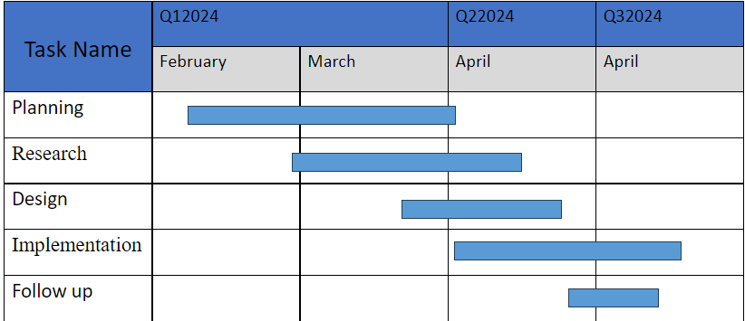
TIMELINE OF THE PROJECT
Gantt Chart

Slide 9

THANK YOU

